Slide 1
IT2771 – Rich Internet Applications
Development
Markup Languages I (HTML)

Slide 2

What is HTML?
A language for describing web pages
  HTML stands for HyperText Markup Language
  HTML is not a programming language, it is a markup language
  A markup language is a set of markup tags
  HTML uses markup tags to describe web pages
http://www.w3schools.com/html/html_intro.asp

Slide 3
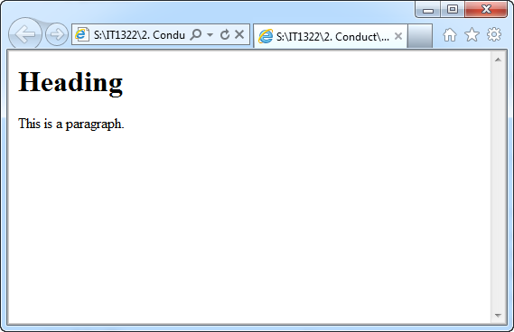
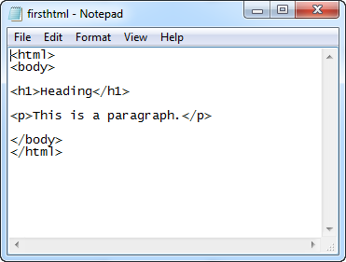
HTML Documents
Web browsers (E.g.: Internet Explorer, Firefox, Chrome)
  Read HTML documents and display them as web pages
  Does not display the HTML tags, but uses the tags to interpret the content of the page
Text between <html> and </html> describes the web page
Text between <body> and </body> is the visible page content
Text between <h1> and </h1> is displayed as a heading
Text between <p> and </p> is displayed as a paragraph
http://www.w3schools.com/html/html_intro.asp
Notes:
Demo: firsthtml.html

Slide 4
.HTM or .HTML File Extension
When you save a HTML file, you can use either the .htm or the .html file extension
There is no difference
index.htm
index.html
is the same
==

Slide 5
HTML Styles
Cascading Style Sheet (CSS) is used to style HTML elements
CSS can be added to HTML in the following ways:
  In Cascading Style Sheets files (CSS files)
  In the <style> element in the HTML head section
  In the style attribute in single HTML elements
Preferred way to add CSS to HTML, is to put CSS syntax in separate CSS files (further discussed in Topic 4)

Slide 6
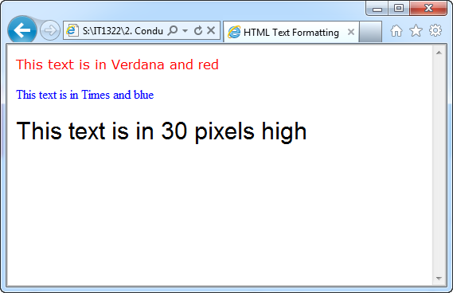
HTML Styles
HTML <font> tag should NOT be used
  Deprecated in HTML 4, and removed from HTML 5
<font size="5" face="arial" color="red">
This paragraph is in Arial, size 5, and in red text color.
</font>
<html>
<head>
<title>HTML Line Breaks</title>
</head>
<body>
<p style="font-family:verdana; color:red;">This text is in Verdana and red</p>
<p style="font-family:Times New Roman; color:blue;">This text is in Times and blue</p>
<p style="font-family:arial; font-size:30px;">This text is in 30 pixels high</p></body>
</html>
Notes:
Demo: html-styles.html

Slide 7
HTML Links
Allow users to click from one page to another
Hyperlink (or link) is a word, group of words, or image that you can click on to jump to a new document or a new section within the current document
Move your cursor over a link in a Web page, the arrow will turn into a little hand
Specified in HTML using <a> tag
<a> tag can be used in two ways:
  To create a link to another document (href attribute)
  To create a bookmark inside a document (name attribute)

Slide 8
HTML Links
href attribute specifies the destination of a link
target attribute specifies where to open the linked document
<a href=“http://www.nyp.edu.sg”>Visit NYP</a>
Clicking on this link with send the user to NYP’s homepage
<a href=“http://www.nyp.edu.sg” target=“_blank”>Visit NYP</a>
Clicking on this link will open linked document in a new browser window or a new tab

Slide 9
HTML Links
name attribute specifies the name of an anchor, used to create a bookmark inside a HTML document
  Bookmarks are not displayed, invisible to the reader
<a name=“aboutus”>About Us Section</a>
Named anchor inside a HTML document
<a href=“#aboutus”>Visit the About Us Section</a>
Create a link to the “About Us Section” inside the same document
<a href=“http://www.nyp.edu.sg/index.html#aboutus”>Visit the About Us Section</a>
Create a link to the “About Us Section” from another page

Slide 10
HTML Images
Images are defined with the <img> tag
<img /> → an empty tag, contains attributes only, has no closing tag
src attribute: URL of the image to be displayed, src stands for “source”
alt attribute: specifies an alternate text for an image
width and height attribute: specifies the height and width of an image, specified in pixels by default
<img src=“images/nyp.gif” alt=“Nanyang Polytechnic” width=“304” height=“225” />
An image named “nyp.gif” located in the “images” directory

Slide 11
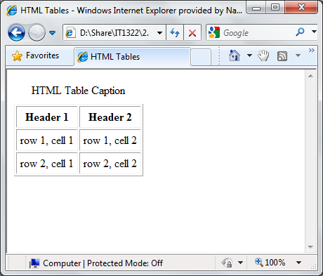
HTML Tables
<table>
<caption></caption>
<th></th> | <th></th>
<td></td> | <td></td>
<td></td> | <td></td>
<td></td> | <td></td>
<html>
<head>
<title>HTML Tables</title>
</head>
<body>
<table border="1" cellpadding="5">
<caption>HTML Table Caption</caption>
<tr>
<th>Header 1</th>
<th>Header 2</th>
</tr>
<tr>
<td>row 1, cell 1</td>
<td>row 1, cell 2</td>
</tr>
<tr>
<td>row 2, cell 1</td>
<td>row 2, cell 2</td>
</tr>
</table>
</body>
</html>
<tr></tr>
</table>
Notes:
Demo: html-tables.html

Slide 12
HTML Lists
Two type of lists: ordered and unordered lists
unordered list:
  Starts with the <ul> tag, each list items starts with the <li> tag
  Items are marked with bullets
ordered list:
  Starts with the <ol> tag, each list items starts with the <li> tag
  Items are marked with numbers

Slide 13
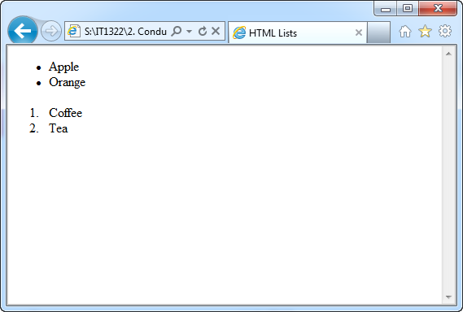
HTML Lists
<html>
<head>
<title>HTML Lists</title>
</head>
<body>
<ul>
<li>Apple</li>
<li>Orange</li>
</ul>
<ol>
<li>Coffee</li>
<li>Tea</li>
</ol>
</body>
</html>
Notes:
Demo: html-lists.html

Slide 14
HTML Forms
Used to select different kinds of user input and pass the data to a server
Contain input elements like text fields, checkboxes, radiobuttons, submit buttons, select lists, text area, fieldset, legend and label elements
<form> tag is used to create HTML form
Tag | Description
<form> | Defines a HTML form for user input
<input /> | Defines an input control
<textarea> | Defines a multi-line text input control
<label> | Defines a label for an input control
<fieldset> | Defines a border around elements in a form
<legend> | Defines a caption for a fieldset element
<select> | Defines a select list (drop-down list)
<optgroup> | Defines a group of related options in a select list
<option> | Defines an option in a select list
<button> | Defines a push button

Slide 15
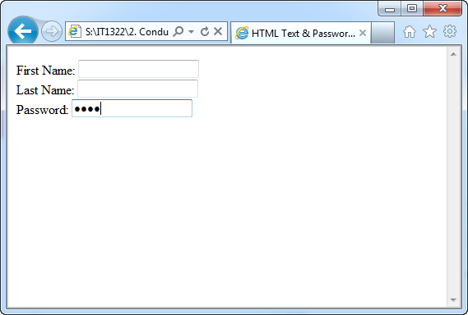
HTML Forms
Text Fields
  <input type=“text” /> defines a one-line input field that a user can enter text into
Password Field
  <input type=“password” /> defines a password field
<html>
<head>
<title>HTML Text & Password Fields</title>
</head>
<body>
<form>
First Name: <input type="text" name="firstname" /> <br />
Last Name: <input type="text" name="lastname" /> <br />
Password: <input type="password" name="password" />
</form>
</body>
</html>
Notes:
Demo: html-textfields.html

Slide 16
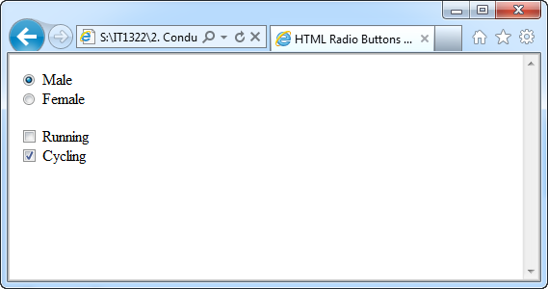
HTML Forms
Radio Buttons
  <input type=“radio” /> defines a radio button, user only allow to select ONE of a limited number of choices, checked attribute makes the state of control selected
Checkboxes
  <input type=“checkbox” /> defines a checkbox, allow user to select ONE or more options of a limited number of choices , checked attribute makes the state of control selected
<html>
<head>
<title>HTML Radio Buttons & Checkboxes</title>
</head>
<body>
<form>
<input type="radio" name="gender" value="male“ checked /> Male <br />
<input type="radio" name="gender" value="female" /> Female <br/><br/>
<input type="checkbox" name="sports" value="running" /> Running <br />
<input type="checkbox" name="sports" value="cycling" checked /> Cycling
</form>
</body>
</html>

Slide 17
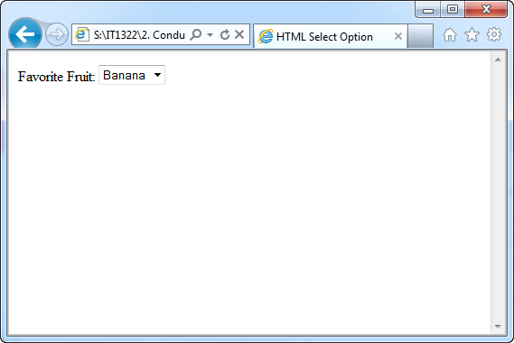
HTML Forms
Select
  <select> defines a drop-down select boxes, user only allow to select ONE of a limited number of choices
  <option> defines the choices in the drop-down select box, selected attribute makes the state of the option selected
<html>
<head>
<title>HTML Radio Buttons & Checkboxes</title>
</head>
<body>
<form>
Favorite Fruit:
<select>
<option value="apple">Apple</option>
<option value="banana" selected>Banana</option>
<option value="orange">Orange</option>
</select>
</form></body>
</html>
Notes:
Demo: html-selectoption.html

Slide 18
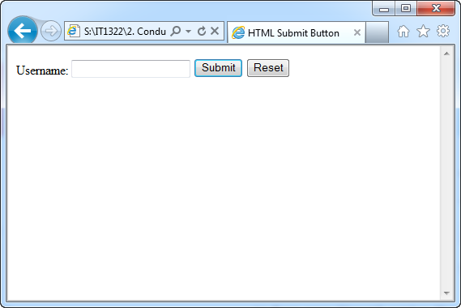
HTML Forms
Submit Button
  <input type=“submit” /> defines a submit button, used to send data to a server. Data is sent to the page specified in the form’s action attribute.
  <input type=“reset” /> defines a reset button, used to clear values in the form
  <input type=“hidden” /> defines hidden value, control not displayed in the form
<html>
<head>
<title>HTML Submit Button</title>
</head>
<body>
<form name="input" action="html_form_action.asp" method="get">
Username: <input type="text" name="username" />
<input type="submit" value="Submit" />
<input type="reset" />
<input type="hidden" name="userid" value="hiddenvalue" />
</form>
</body>
</html>
Notes:
Demo: html-submit.html

Slide 19
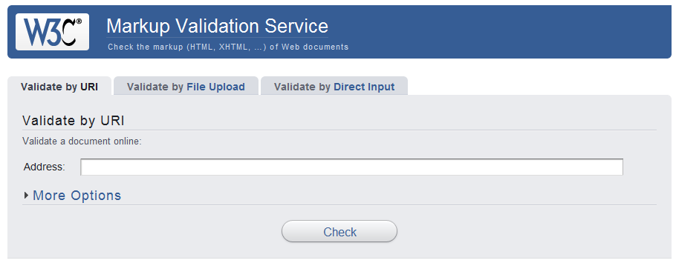
Validate HTML code
Automated process of comparing your written code against current coding standard by using validator
  W3C Validator (http://validator.w3.org/)
  Chrome Addon – HTML Validator

Slide 20
Summary
Use lowercase for tag and attribute
All tags must be nested properly and not overlap
HTML Basic Document
<html>
<head>
<title>Document Title</title>
</head>
<body>
Content of document
</body>
</html>
Heading Elements
<h1>Largest Heading </h1>
<h2> . . . </h2>
<h3> . . . </h3>
<h4> . . . </h4>
<h5> . . . </h5>
<h6>Smallest Heading</h6>
Text Elements
<p>This is a paragraph </p>
<br /> (line break)
<hr /> (horizontal rule)
<!-- This is comment -->
<em>This text is emphasized</em>
<strong>This text is strong</strong>
<b> This text is bold </b>
<i>This text is italic</i>
Links
<a href=“index.html”>Link text</a>
Named anchor:
<a name=“aboutus”>About Us</a>
<a href=“#aboutus”>Jump to About Us</a>
Unordered List
<ul>
<li>Item</li>
<li>Item</li>
</ul>
Ordered List
<ol>
<li>Item 1</li>
<li>Item 2</li>
</ol>

Slide 21
Summary
Tables
<table border=“1” cellpadding=“5” cellspacing=“5”>
<caption>Table Caption</caption>
<tr>
<th>Table Header</th>
<th>Table Header</th>
</tr>
<tr>
<td>Table Data</td>
<td>Table Data</td>
</tr>
</table>
Forms
<form action=“some_page.asp” method=“get/post”>
<input type=“text” name=“email” />
<input type=“password” />
<input type=“checkbox” checked />
<input type=“radio” checked/>
<input type=“submit” value=“Submit” />
<input type=“reset” />
<input type=“hidden” />
<select>
<option>Apples</option>
<option selected>Bananas</option>
<option>Cherries</option>
</select>
</form>
To learn more about HTML, refer to http://www.w3schools.com/html

